Slide 1

Predict the Price of Used Cars in Saudi Arabia

Slide 2

Background & Goal

Slide 3
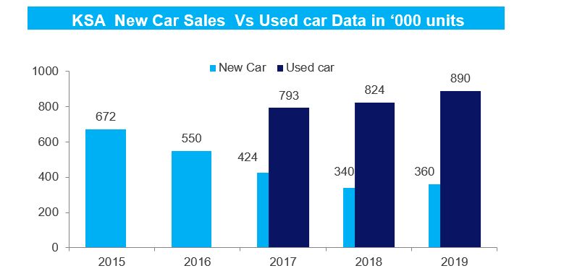
Market Opportunities for Used Cars in Saudi Arabia

Slide 4
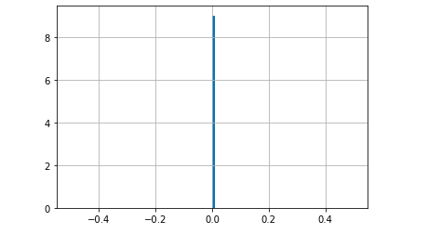
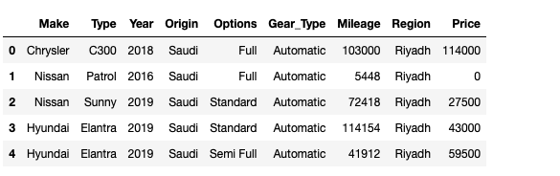
Data Preparation
First data set: OBTAIN from Kaggle. It is very fresh data because it gathered in 10 months ago.
The dataset contains 8035 rows with 8 features .
Lots of unneeded data and was removed to obtain good outcome of Price.
Categorical variables such as Make, type, Gear-type were change to numeric variables

Slide 5
My research Questions
To Predict the Price cars given the features
Which manufactures have the highest resale value?
Which Gear-type has higher value in the Market.?
Which Type of cars are very expensive used in Saudi Arabia?
Which Options (Full , Standard , Semi Full) have higher value in the Market.?
Which cities in Saudi Arabia have the majorities of used cars.
These questions can be answered by using exploratory analysis

Slide 6
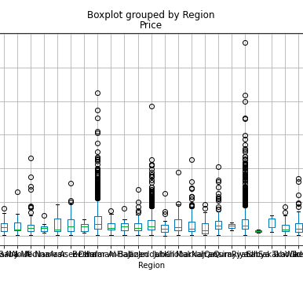
My research Questions
The Models that are used are :
Baseline Model, in our case, RandomForestRegressor model: RandomForests are a modification of bagging that builds a large collection of de-correlated tress and have become a very popular “out-of –the-box “ learning algorithm that enjoys good predative performance.
Lasso
KNeighborsRegressor

Slide 7
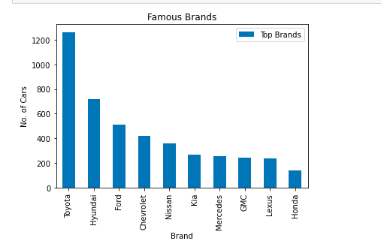
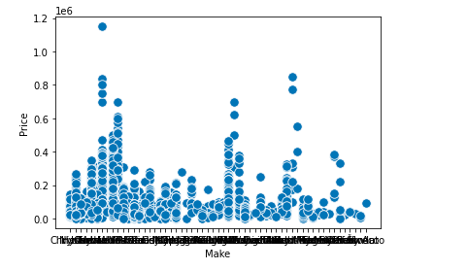
Which manufactures have the highest resale value?

Slide 8
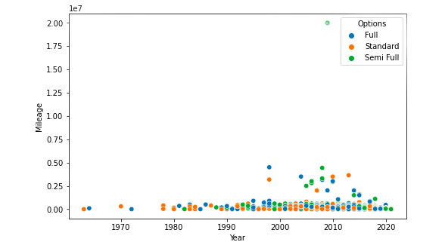
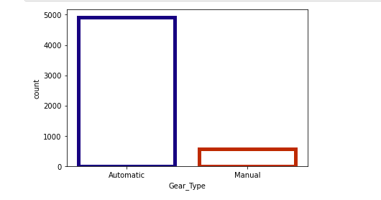
Which Gear-type has higher value in the Market?

Slide 9
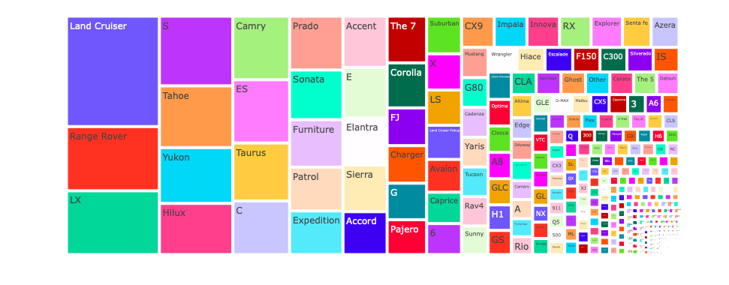
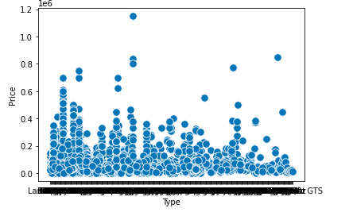
Which Type of cars are very expensive used in Saudi Arabia?

Slide 10
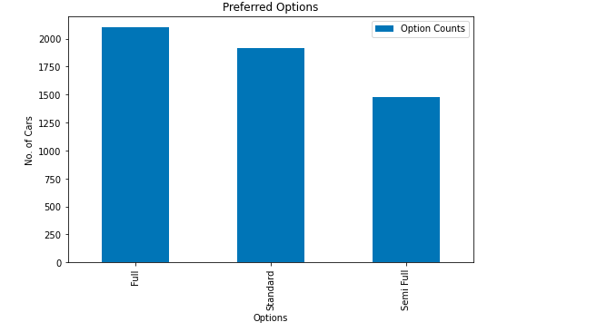
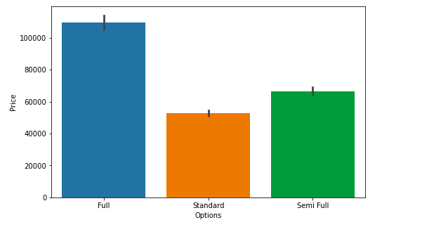
Which Options (Full , Standard , Semi Full) have higher value in the Market.?

Slide 11
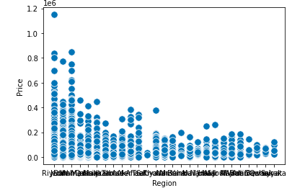
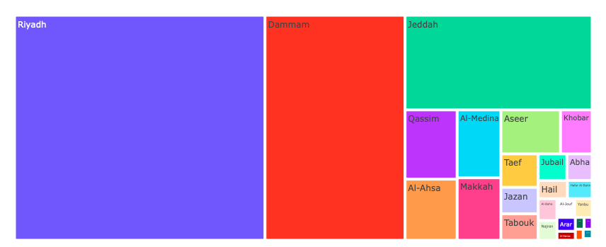
Which cities in Saudi Arabia have the majorities of used cars.

Slide 12
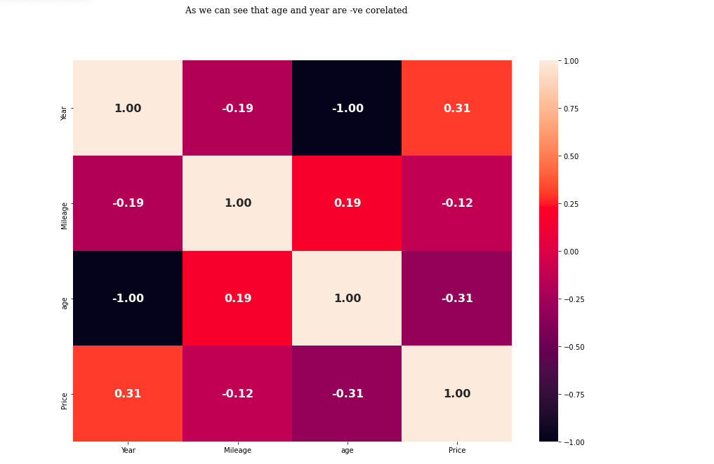
heatmap

Slide 13
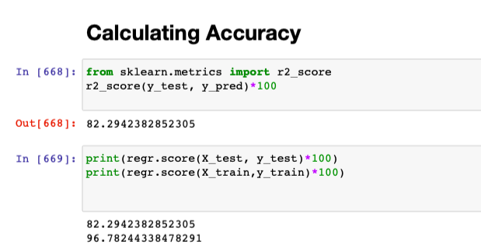
Baseline Model, in our case, RandomForestRegressor
Models are run using Python in Jupyter Notebook
There is many categorical columns in the data, So I have done Label Encoding.
The test set is 20% of overall dataset.
Performance metrics after running the model:

Slide 14
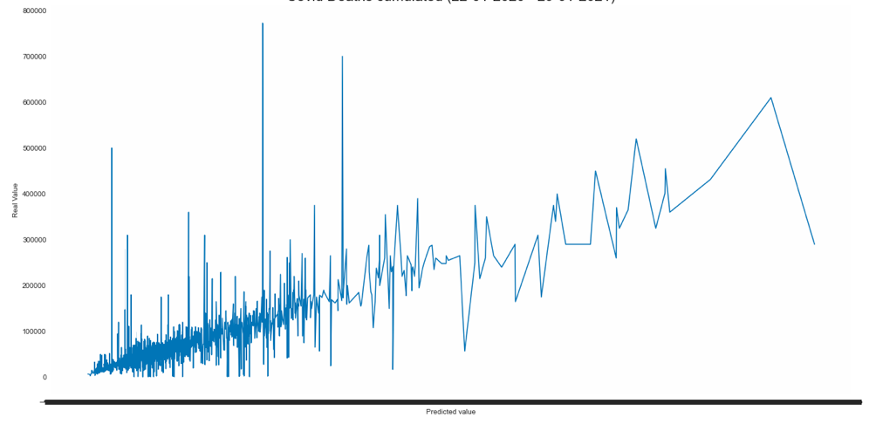
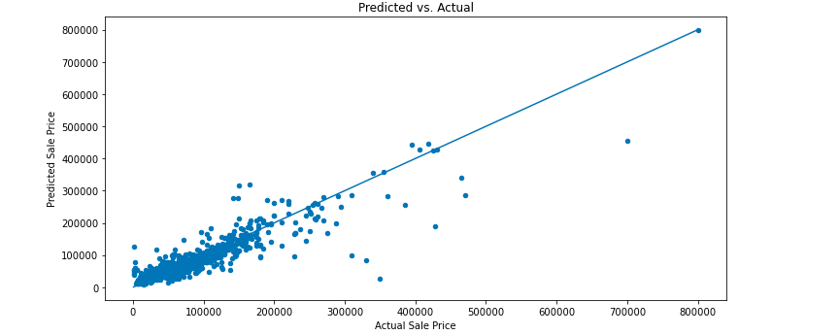
The polt between Predicted price and actual price

Slide 15
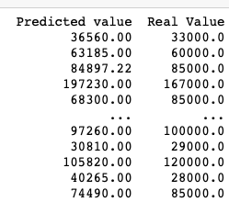
the old price and the new price

Slide 16
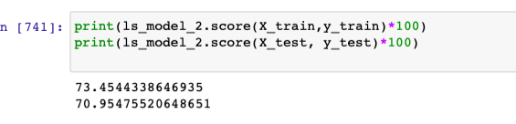
Lasso
Performance
metrics after running the model:

Slide 17
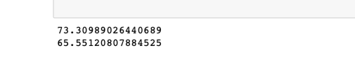
KNeighborsRegressor
Performance
metrics after running the model:

Slide 18
Conclusion & FUTURE WORKS
We have developed model to predict car price problem.
First, we made the detailed exploratory analysis.
We have decided which metric to use. We analyzed both target and features in detail. We transform categorical variables into numeric so we can use them in the model. We transform numerical variables to reduce skewness and get close to normal distribution. We looked at the results of the each model and selected the best one.
FUTURE WORKS: Keeping the current model as a baseline, we intend to use some advanced techniques algorithms to predict car prices as my future work.

